Slide 1


Fundamentals of Predictive Analytics using Machine Learning techniques (40 hr)

Slide 2
In this section, we will discuss:
Machine learning and its types & applications
Supervised machine learning techniques
Classification vs. regression
Understanding Regression and types
Linear regression using OLS
Multi-Variate Linear Regression
Correlation concepts
Metrics- Loss function, MSE, RMSE, MAE, R2 Score

Slide 3
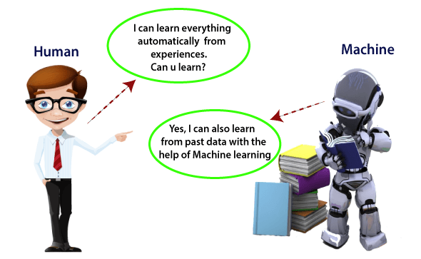
Machine learning and its types & Applications
Machine learning
AI Approach that uses a system that is capable of learning from experience without having to be programmed.
Image Source:
https://static.javatpoint.com/tutorial/machine-learning/images/introduction-to-machine-learning.png

Slide 4
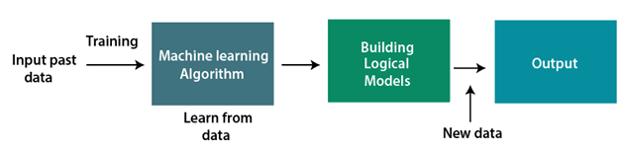
Machine learning and its types & Applications
How does Machine Learning Work?
Learns from historical data, builds the prediction models, and whenever it receives new data, predicts the output for it.
Image Source:
https://static.javatpoint.com/tutorial/machine-learning/images/introduction-to-machine-learning2.png

Slide 5
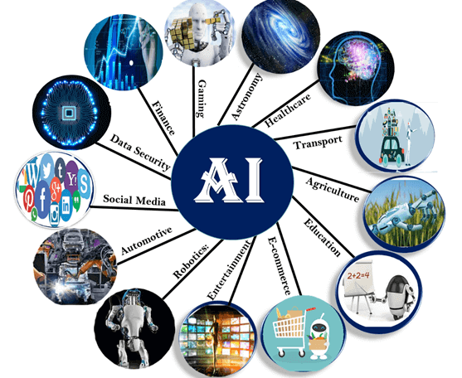
Machine learning and its types & Applications
Applications
Image Recognition
Speech Recognition
Traffic prediction
Product recommendations
Self-driving cars
Email Spam and Malware Filtering
Virtual Personal Assistant
Online Fraud Detection
Stock Market trading
Medical Diagnosis
Automatic Language Translation
Image Source: https://www.javatpoint.com/machine-learning

Slide 6
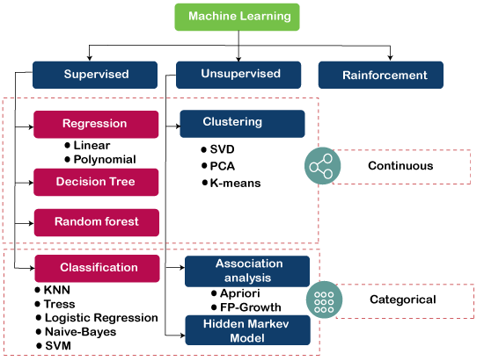
Machine learning and its types & Applications
Types
Supervised Learning
Unsupervised Learning
Reinforcement Learning
Image Source: https://static.javatpoint.com/tutorial/machine-learning/images/machine-learning-algorithms.png

Slide 7
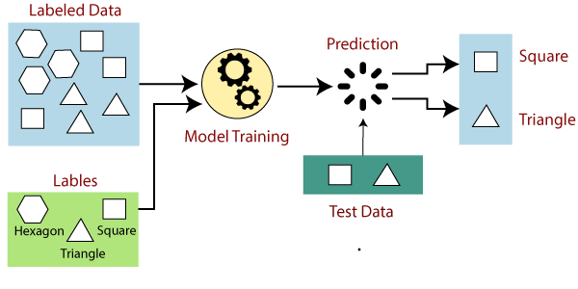
Machine learning and its types & Applications
Supervised Learning
It is a process of learning algorithm from the training dataset.
Using input and output variable, an algorithm is used to learn the mapping function from the input to the output.
Image Source: https://static.javatpoint.com/tutorial/machine-learning/images/supervised-machine-learning.png

Slide 8
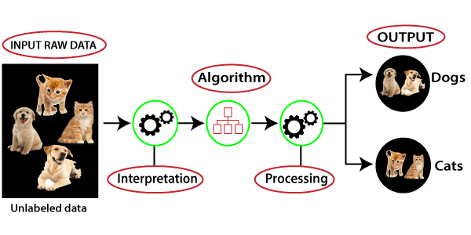
Machine learning and its types & Applications
Unsupervised Learning
Modeling the underlying or hidden structure or distribution in the data in order to learn more about the data.
Only have input data and no corresponding output variables.
Image Source: https://static.javatpoint.com/tutorial/machine-learning/images/unsupervised-machine-learning-1.png

Slide 9
Machine learning and its types & Applications
Supervised Learning
It is a process of learning algorithm from the training dataset.
Using input and output variable, an algorithm is used to learn the mapping function from the input to the output.
Image Source: https://static.javatpoint.com/tutorial/machine-learning/images/supervised-machine-learning.png

Slide 10
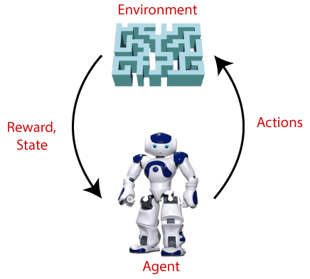
Machine learning and its types & Applications
Reinforcement Learning
Model keeps on increasing its performance using a reward feedback to learn the behavior or pattern.
Markov decision process, Bellman’s equation, Q-learning, SARSA (state-Action-Reward-State-Action), Deep Q-network
Image Source: https://static.javatpoint.com/tutorial/reinforcement-learning/images/what-is-reinforcement-learning.png

Slide 11
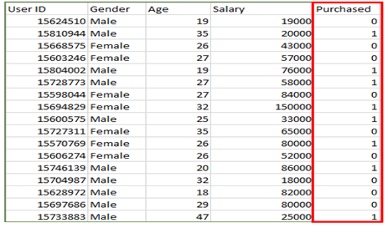
Supervised machine learning techniques
Classification
Classification is a process of finding a function which helps in dividing the dataset into classes based on different parameters.
Output is having discrete value.
Image Source: https://media.geeksforgeeks.org/wp-content/uploads/supervised-data.png

Slide 12
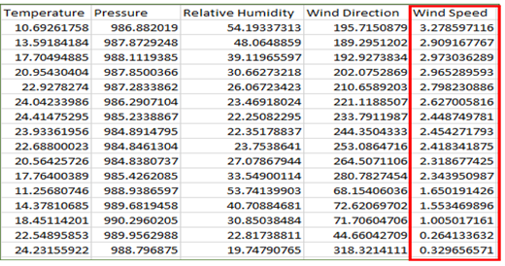
Supervised machine learning techniques
Regression
Regression analysis is a statistical method to model the relationship between a dependent (target) and independent (predictor) variables with one or more independent variables.
Output is having continuous value.
Image Source: https://media.geeksforgeeks.org/wp-content/uploads/supervised-data.png

Slide 13
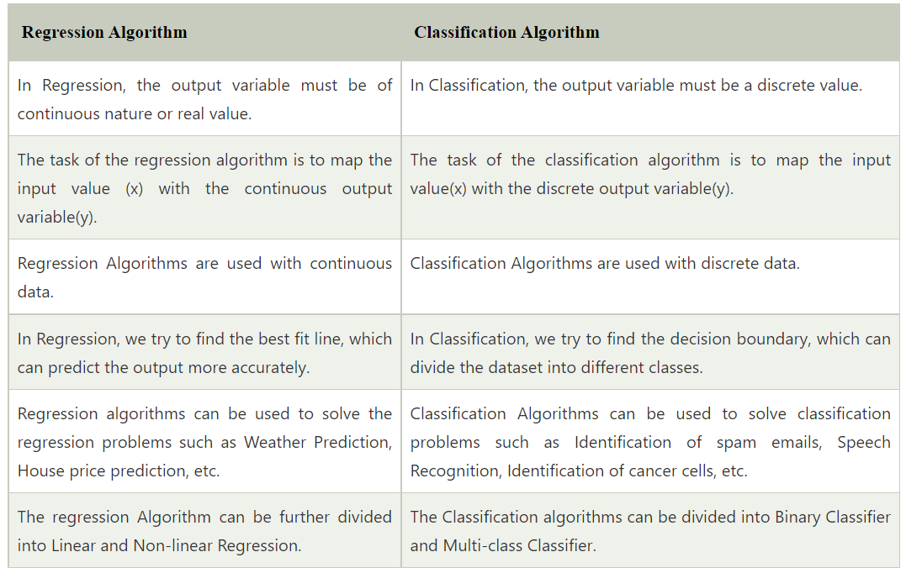
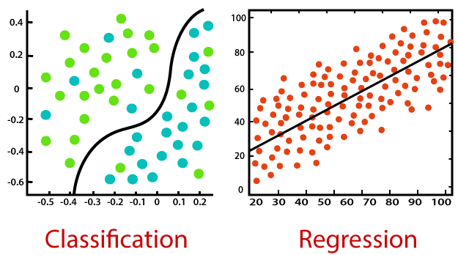
Classification vs. Regression
Image Source: https://static.javatpoint.com/tutorial/machine-learning/images/regression-vs-classification-in-machine-learning.png

Slide 14
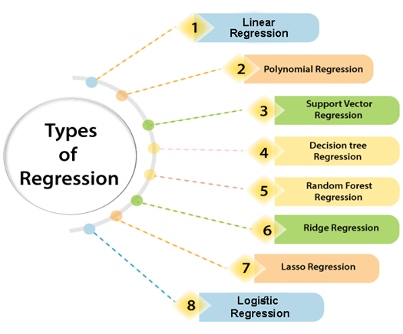
Understanding Regression and Types
Types
Linear Regression
Logistic Regression
Polynomial Regression
Support Vector Regression
Decision Tree Regression
Random Forest Regression
Ridge Regression
Lasso Regression:
Image Source: https://static.javatpoint.com/tutorial/machine-learning/images/types-of-regression.png

Slide 15
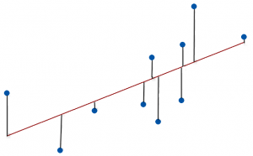

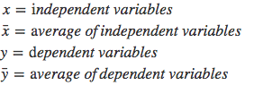
Linear regression using OLS
Ordinary Least Squares
Ordinary least squares, or linear least squares, estimates the parameters in a regression model by minimizing the sum of the squared residuals.
This method draws a line through the data points that minimizes the sum of the squared differences between the observed values and the corresponding fitted values.
Image Source: https://statisticsbyjim.com/glossary/ordinary-least-squares/#:~:text=Ordinary%20least%20squares%2C%20or%20linear,and%20the%20corresponding%20fitted%20values

Slide 16
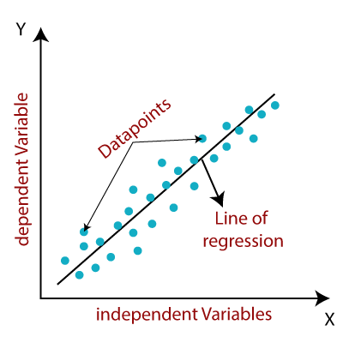
Understanding Regression and Types
Linear Regression
Relationship between a dependent (y) and one or more independent (y) variables.
Image Source: https://static.javatpoint.com/tutorial/machine-learning/images/linear-regression-in-machine-learning.png

Slide 17
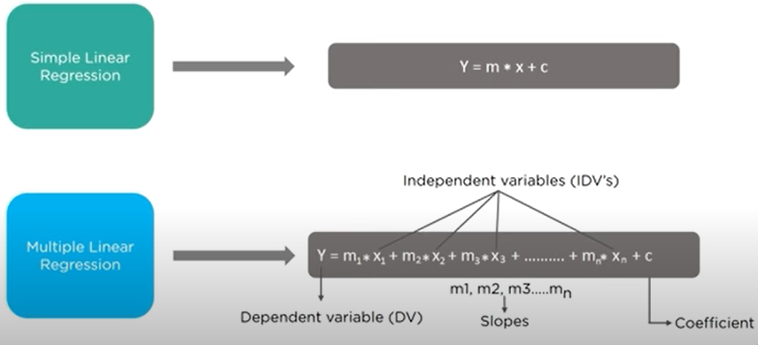
Understanding Regression and Types
Linear and Multiple Regression
Multiple regression is a broader class of regressions that encompasses linear and nonlinear regressions with multiple explanatory variables.
Whereas linear regress only has one independent variable impacting the slope of the relationship, multiple regression incorporates multiple independent variables.
Image Source: https://static.javatpoint.com/tutorial/machine-learning/images/linear-regression-in-machine-learning.png

Slide 18
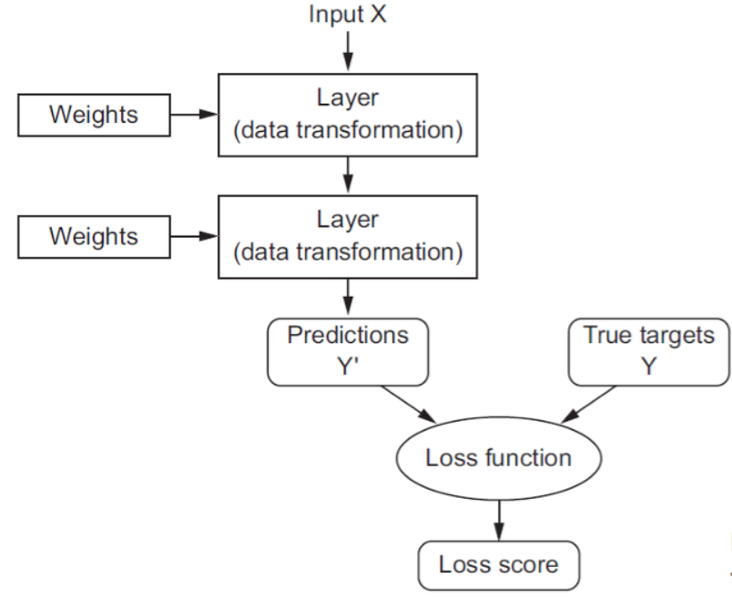
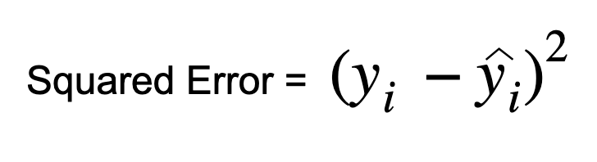
Metrics
Loss Function
A function that calculates loss for 1 data point is called the loss function.
Image Source: https://miro.medium.com/max/1400/0*D88aae6e_CG35R1p.png

Slide 19

Metrics
Mean Squared Error (MSE) / Mean Squared Deviation (MSD)
It basically calculates the difference between the estimated and the actual value, squares these results and then computes their average.
MSE can only assume non-negative values .
ŷᵢ→ Predicted, yᵢ→ Actual
Image Source: https://miro.medium.com/max/682/0*omsdYpfRvm3ALVaO

Slide 20

Metrics
Root Mean Squared Error (RMSE) / Root Mean Squared Deviation (RMSD)
RMSE calculates the average of the squared errors across all samples but, in addition, takes the square root of the result.
Image Source: https://miro.medium.com/proxy/0*d3UTunsQ5djTl-4G

Slide 21

Metrics
Mean Absolute Error (MAE)
It simply calculates the absolute value of the errors and then takes the average of these values.
Image Source: https://miro.medium.com/max/650/0*sTJz5_kSQua4iNE8

Slide 22
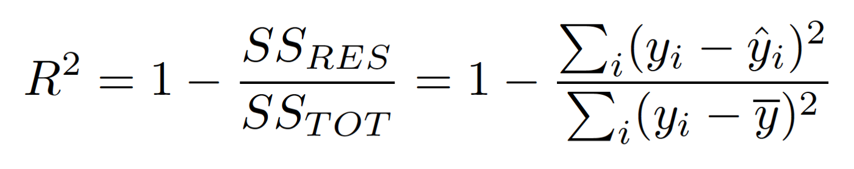
Metrics
R Squared (R²) / Coefficient of Determination
R Squared (R²) represents the proportion of the variance for the dependent variable y that’s explained by the independent variables X.
R² explains to what extent the variance of one variable explains the variance of the second variable
If the R² of a model is 0.75, then approximately 75% of the observed variation can be explained by the model’s features..
Image Source: https://miro.medium.com/max/1400/0*5-k42pnh0PpJhw-E

